Slide 1
Resumes 101
Prakit Mohal
October 23, 2024

Slide 2
Agenda
Introductions
Resume Format
Beyond the Resume
Initial Q&A
Breakout Rooms
We can then do a more individual review if you have specific questions about your resume

Slide 3
About Me
Graduated from MI G (University of Michigan) with a BSE in Electrical Engineering in 2009
Received an MBA from the University of Rochester in 2015
Have worked at Fortune 500 companies in the past as a developer, then supporting sales, and then as a Product Manager
Currently working as a Lead Product Manager at a consulting firm focusing on Civic Tech

Slide 4
What is your resume experience?
I’ve recruited interns and recent college graduates at previous employers
I have also interviewed prospective employees and made candidate decisions for openings for entry level and experienced candidates

Slide 5
Disclaimers
I have never worked for career services and am not familiar with any specific rules for your university
Example: If your university or department has a policy regarding GPAs on resumes, I do not know what they are
This guidance is for students looking for internships and first jobs out of college and some parts won’t be as relevant to more experienced candidates
You don’t need to put your courses on your resume 15 years out of college

Slide 6
Resume Format
Your resume will most likely be parsed if you’re applying online, so keep it standardized
Fields include
Name & Contact Info
Summary statement
Education
Experience
Activities

Slide 7
Resume Format (continued)
This is generally the rough order that I expect to find, but it may vary depending on your department guidelines
It is highly unlikely that your resume will exceed one page in length
If it does do not double sides your resume, because most resume notes are taken on the back of them

Slide 8
What should be in the header?
At minimum you’ll need your name, phone number, and email address
If you have a code repository on something like GitHub that’s always good to include
Similarly, if you have a website that you have hosted to show off your portfolio you can include that as well
Expect that the people interviewing you will try to access your websites, so please test them on mobile devices and make sure they are professional!
Hyperlinks are helpful for those with a digital copy of your resume

Slide 9
Summary Statement
Generally, a few sentences long
This is a good place to list what your focus areas are, especially if it isn’t obvious from your resume
You can also list if you’re looking for full time/internship and when you can start
Think about it this way: what makes you different from everyone else applying?

Slide 10
Education
Many of your peers have had similar classes so try to highlight what makes you unique
I recommend including the course numbers so that if the person reviewing your resume went to your school, they can immediately figure out what courses you’ve taken
You should be including if you’ve gotten inducted into any honor societies
I always try to look for lines like TBP if I’m reviewing resumes

Slide 11
GPA
If your GPA is high include it
If your GPA isn’t it’s a judgement call
Some companies may overlook a missing one while others may discard it
In personal experience it was one of the first things I’d look for and it was almost always bad news when it wasn’t listed
In my experience if it was above a 3.0 it should be included

Slide 12
Experience
If you’ve had internships in the past this is the place to highlight them
If you haven’t had an internship, you can include things like research projects or other activities
If you have any publications, you want to list them
This is also a great place to highlight any student jobs that may be relevant such as being a TA for a class
Even if it’s a required course, you could list a project especially if it stood out, such as a capstone project
Unless you’re really lacking for experience, I would not put your summer job flipping burgers at Sheetz
If you must resort to that try to highlight any leadership roles that you can

Slide 13
Diving into Experience
Bullets should be in the STAR (Situation/Task-Action-Result) or ACR (Action-Context-Result) format
Created presentations
for major government clients
leading to a 20% increase in division revenue
You’ll want to clearly highlight what YOU did; this is not the time to be modest!
You will be asked about what you’re claiming, so please be able to back them up

Slide 14
Activities
This is where to include all the outside of class activities you participate in
Format is generally organization, role, time period
Highlight any leadership experience of any groups, no matter how small they are
I’d rather see leadership in a small group than being a member of a lot of large groups
If you’re involved in any cool or unusual activities, you should list those as well since it makes a great conversation starter

Slide 15
What else should I include
If you have had a security clearance list it if you’re applying to anything government related, it means an instant cost savings for the employer
Having your visa/citizenship status listed is fine and even helps if you’re specifically looking to be sponsored
Many companies can’t sponsor or can't hire green card holders and it saves everyone time
Including fluency in other languages could open doors for multinational companies that operate in those regions

Slide 16
Standing Out
If you have any unique experiences include them in your resume
The one thing I got asked the most was about my study abroad in China even though that was a very small part of my experience in college
Get involved with leadership activities
It proves that you are a leader and that you can handle tough situations, and it makes a great conversation starter

Slide 17
Tailoring your resume
There is no harm in having multiple versions of your resume for different companies
If you’re interested in both software and hardware companies having specific resumes for both instead of a generic one can help highlight your experiences better
I would not recommend having a resume that explicitly calls out the company you want to work for, however
That looks as if you’re trying too hard ☺

Slide 18
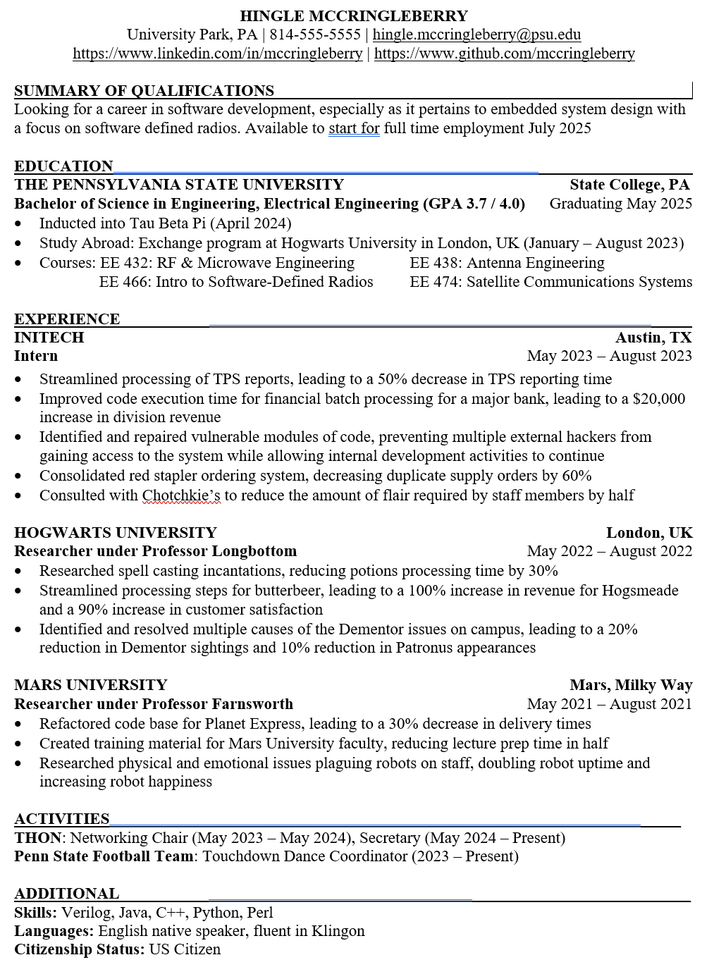
What should it look like?
Yes, this is a clearly fake resume, but the formatting is what you’re aiming for
This presentation and resume will be available if you want to use this as a guide

Slide 19
Submitting a resume
Your resume should almost always be in PDF format
You’d be surprised how awful your beautifully formatted Word for Windows resume looks on Apple Pages
Exception: if you’re having someone review your resume Word/Google Docs makes it a lot easier to make suggestions without them having to back convert it

Slide 20
Cover Letters
Having a cover letter can’t hurt, especially if you’re applying for a smaller firm that has time to read them
It’s especially useful if you’re trying to pivot into something that may not be obvious from your resume
Full disclosure: I can’t say if a cover letter has helped me get any of my jobs and I don’t recall reading very many of them

Slide 21
What else should I know?
Make sure your resume is free of errors, if you have too many it’s easy to throw you on the discard pile
Don’t give anyone an excuse to reject your resume
Try to have multiple people review your resume to get feedback
At a certain point you’ll hit diminishing returns and reviewers contradicting each other but the first one or two passes will be illuminating
I still get my resume reviewed by my friends to this day
Keep your resume up to date
You never know who may ask for it and you don’t want to scramble to edit it

Slide 22
Using AI
ChatGPT and similar tools are all the rage right now
Note that it’s obvious when someone has told ChatGPT to create a resume or cover letter for them
It’s helpful to use it as a guide and to double check your work, but don’t solely rely on it

Slide 23
I’ve got a resume what now
Apply to companies, whether online or at your career fair
Yes, applying online does work, and may even be a requirement even if you hand over a paper resume so that you’re “in the system”
No company is beneath you
That company with the nonexistent line with the bored looking reps would LOVE for you to talk to them, and you may learn something cool about them too
You’d be surprised what those more unknown companies are up to; my first employer sent me to UAE, Romania, and Bulgaria, places I never would’ve gone to otherwise

Slide 24
What do you look for at a career fair?
I will first ask if you’ve heard of us and know anything about what we do
I will then look and try to find interesting things on your resume to talk about to try to gauge interest
I will also try to look for applicable experience
If you did a project for a major bank and you’re applying to financial services companies, you better have that listed so that they can ask you about it and help bump you up over other candidates without that experience

Slide 25
Sweet I got an interview
If you get an email address thank your interviewer! They appreciate it
An occasional follow up is fine, but keep in mind the person interviewing you isn’t necessarily the one making hiring decisions
Even if you don’t get selected ask for feedback
It’s rare that you’ll get it but the further along in the process the more likely it is you’ll get something actionable

Slide 26
I got an offer letter!
Congrats!
Even if it wasn’t your first choice that’s still a major accomplishment
Don’t do anything silly, keep up the good work so your offer won’t get rescinded

Slide 27
Questions?
Remember: we’ll be going to breakout rooms if you have questions specific to your resume!

